Slide 1
CAPE WINELANDS
BOT RIVER

Slide 2
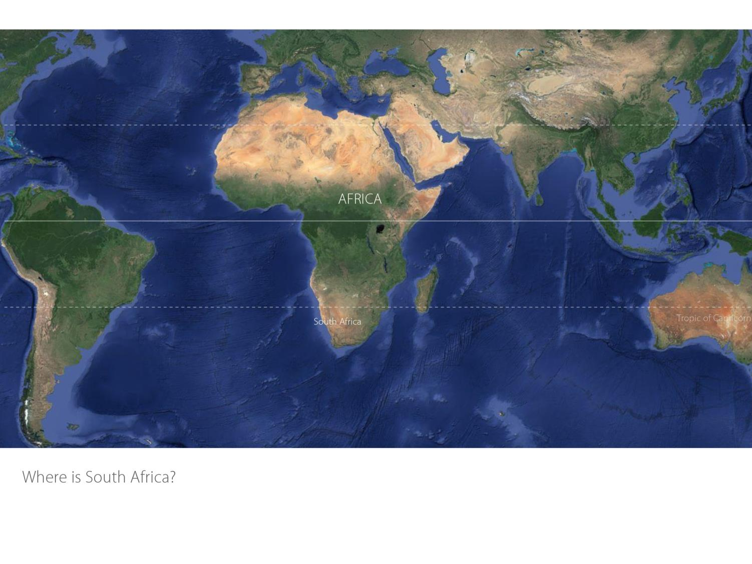

Slide 3
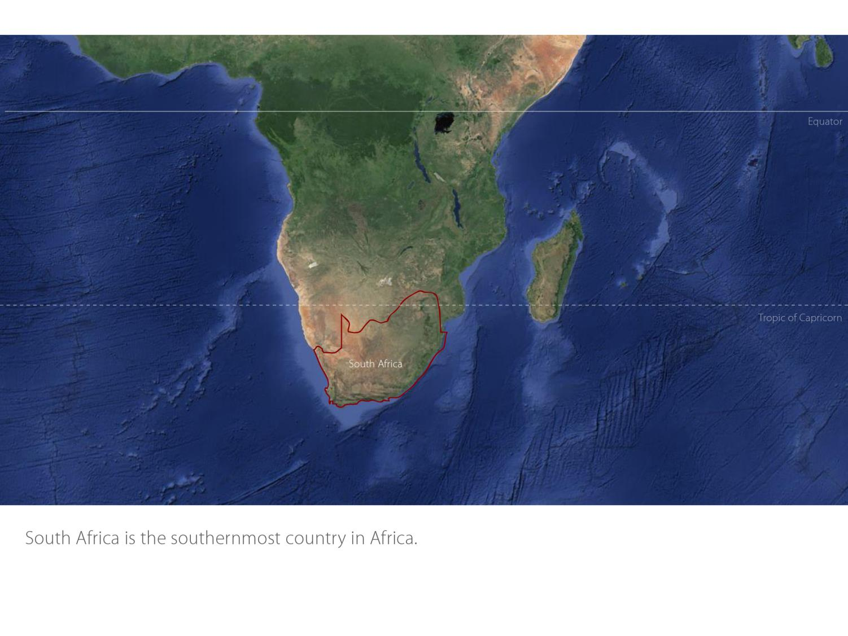

Slide 4
Our winelands are located at the very tip of South Africa.
Bot River
Cape South Coast

Slide 5
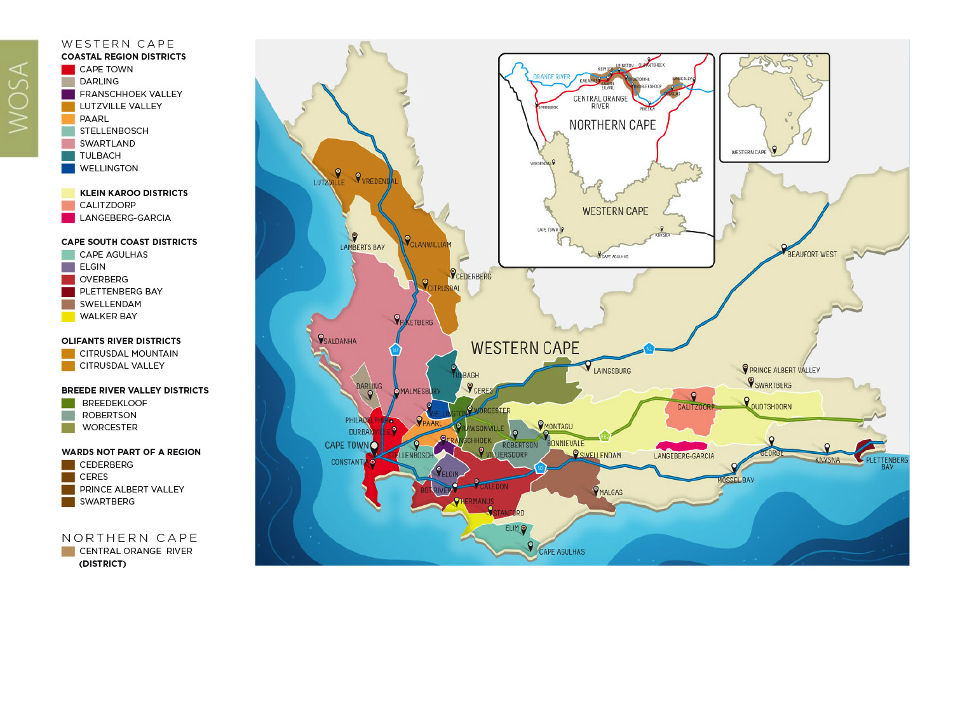
PRODUCTION AREAS: Districts of South Africa.
Bot River
Cape South Coast

Slide 6
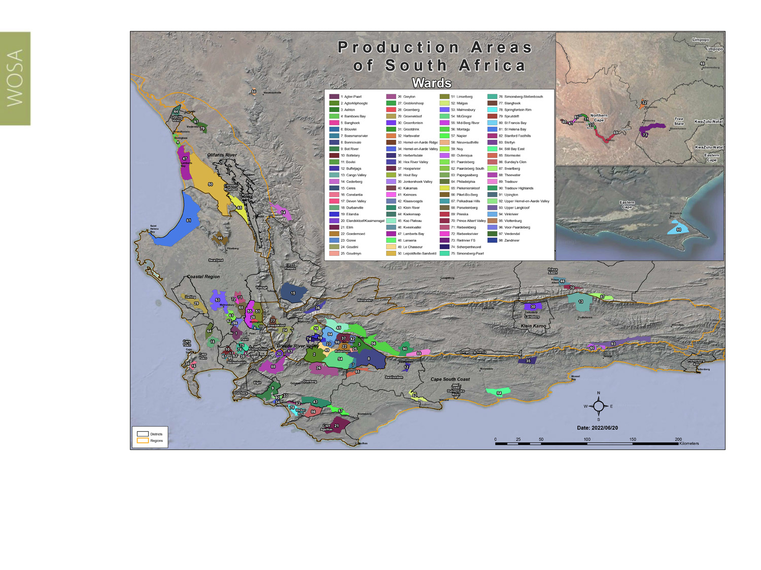
Wards of South Africa.
Bot River
Cape South Coast

Slide 7
Bot River
Cape South Coast

Slide 8
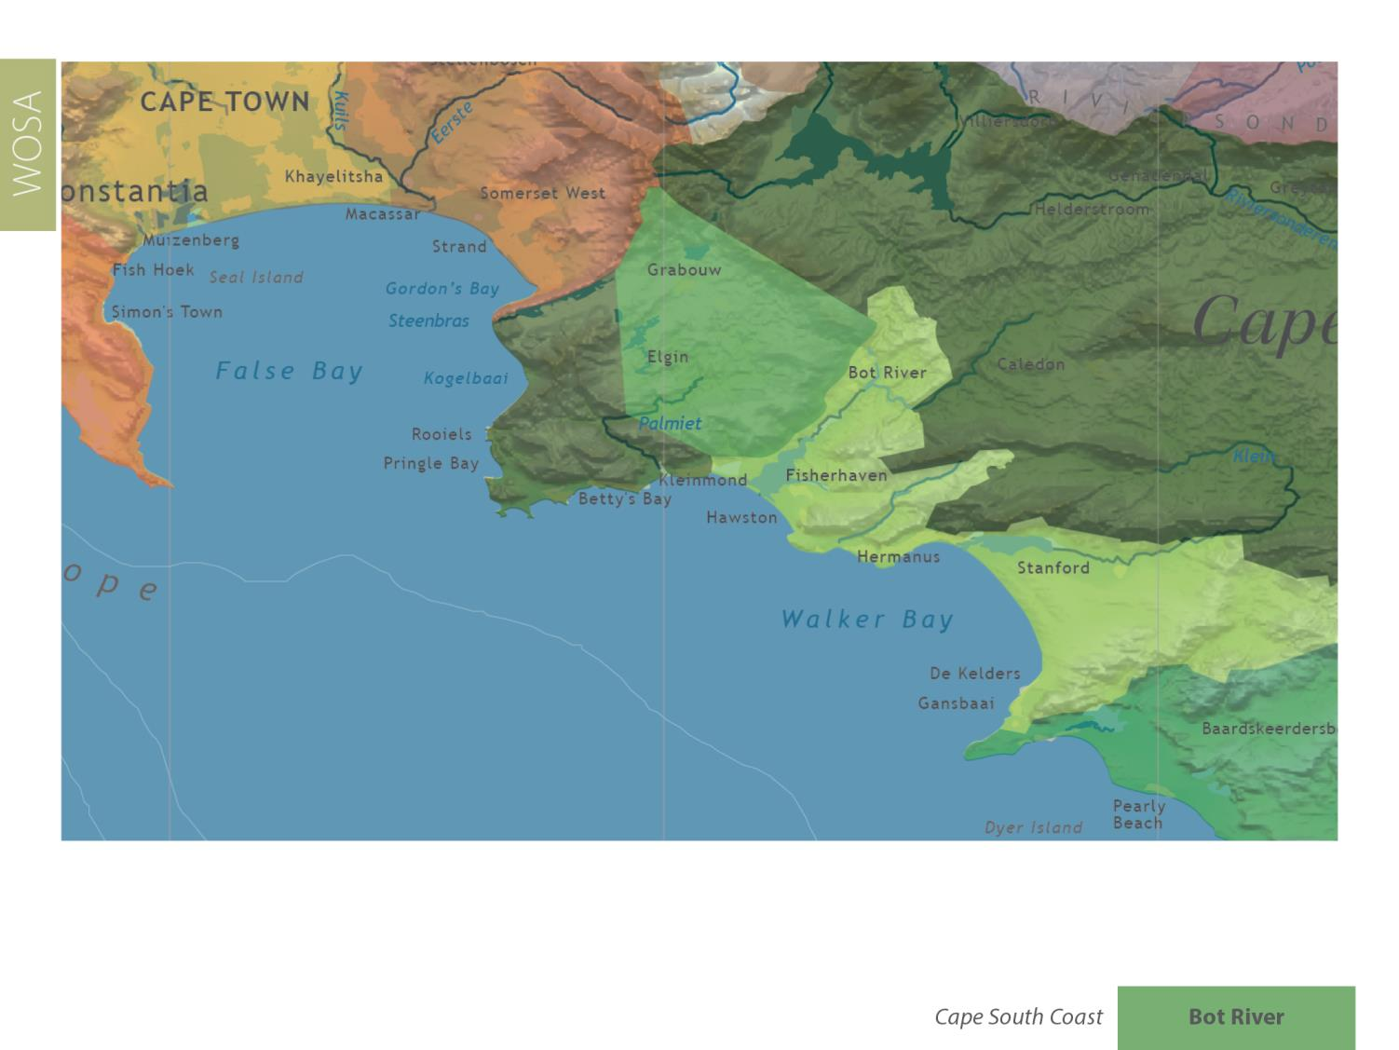
Bot River
Cape South Coast

Slide 9
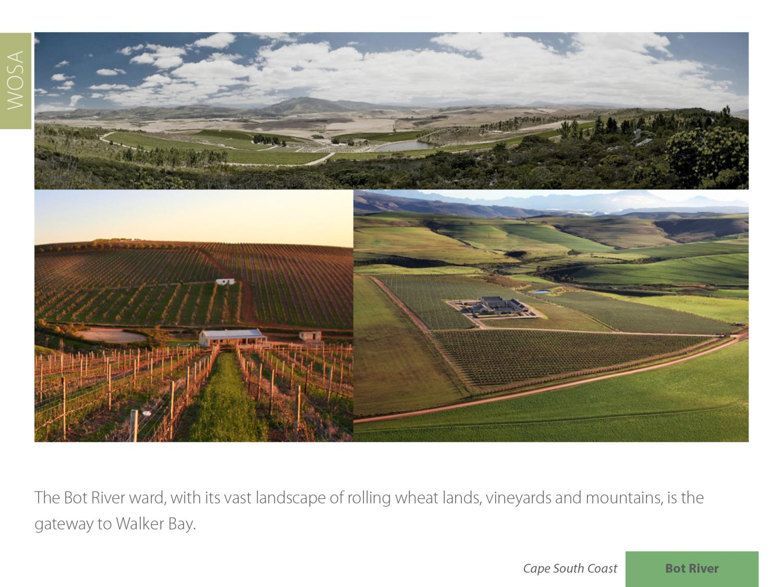
Bot River
Cape South Coast

Slide 10
Bot River
Cape South Coast

Slide 11
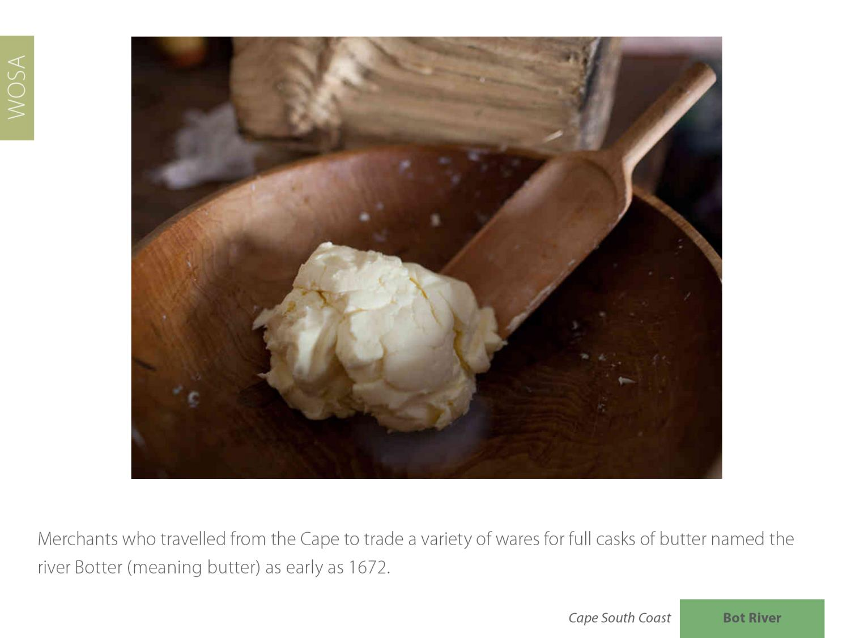
Bot River
Cape South Coast

Slide 12
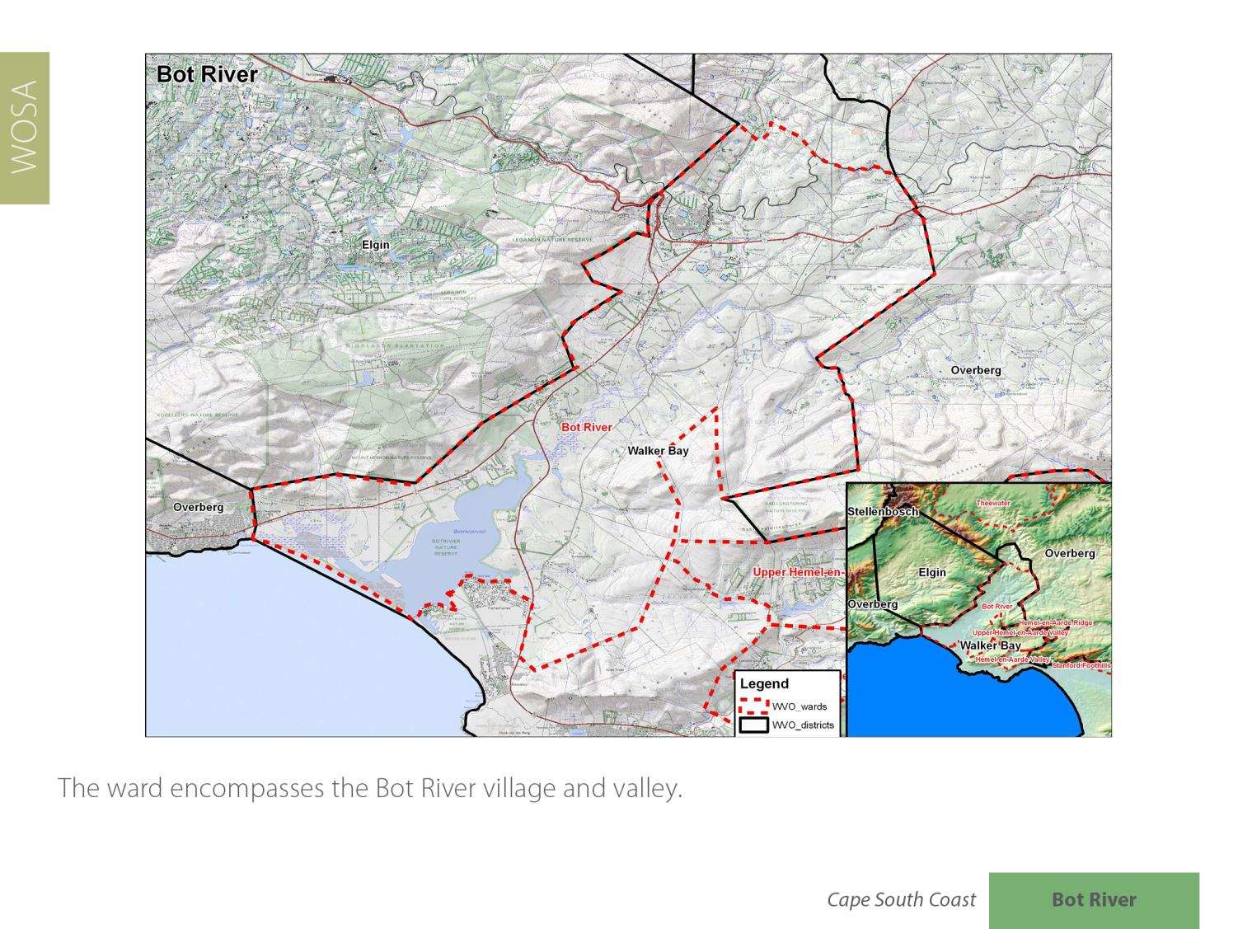
Bot River
Cape South Coast

Slide 13
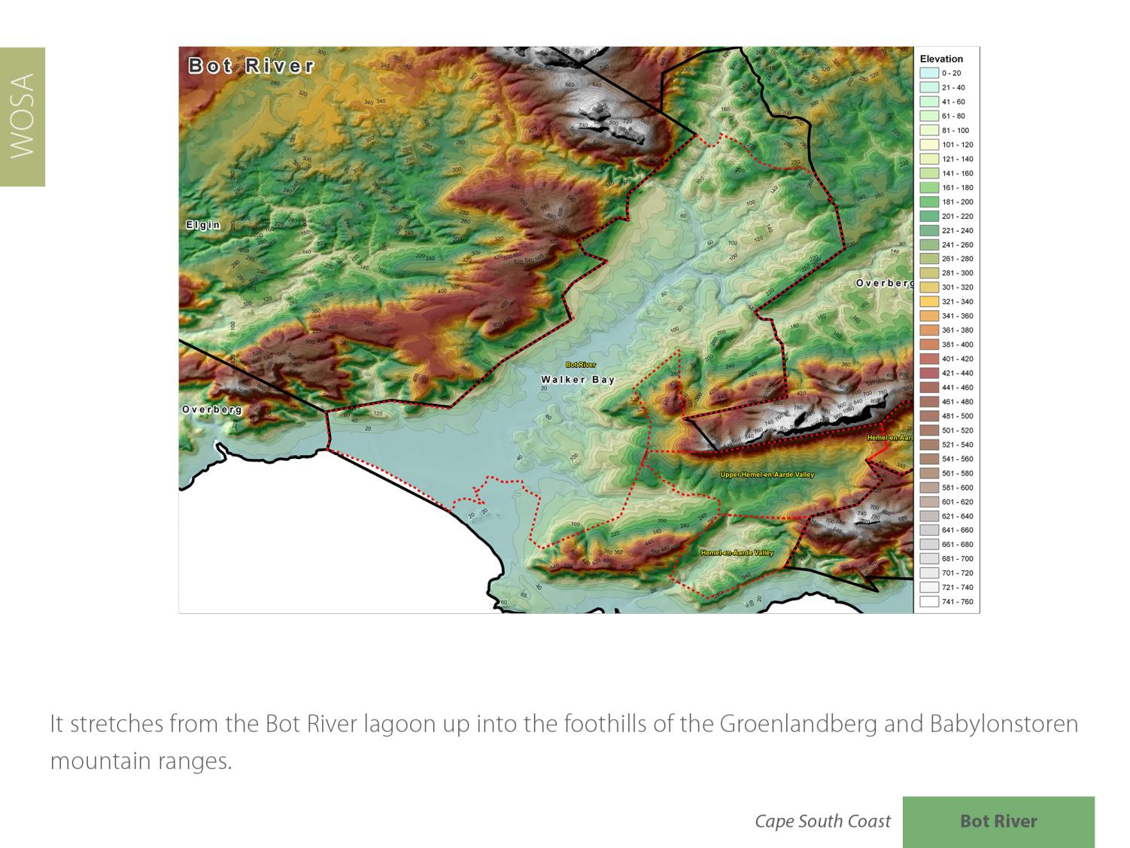
Bot River
Cape South Coast

Slide 14
Most of the wineries are centred within a 10 km radius around the village.
Bot River
Cape South Coast

Slide 15
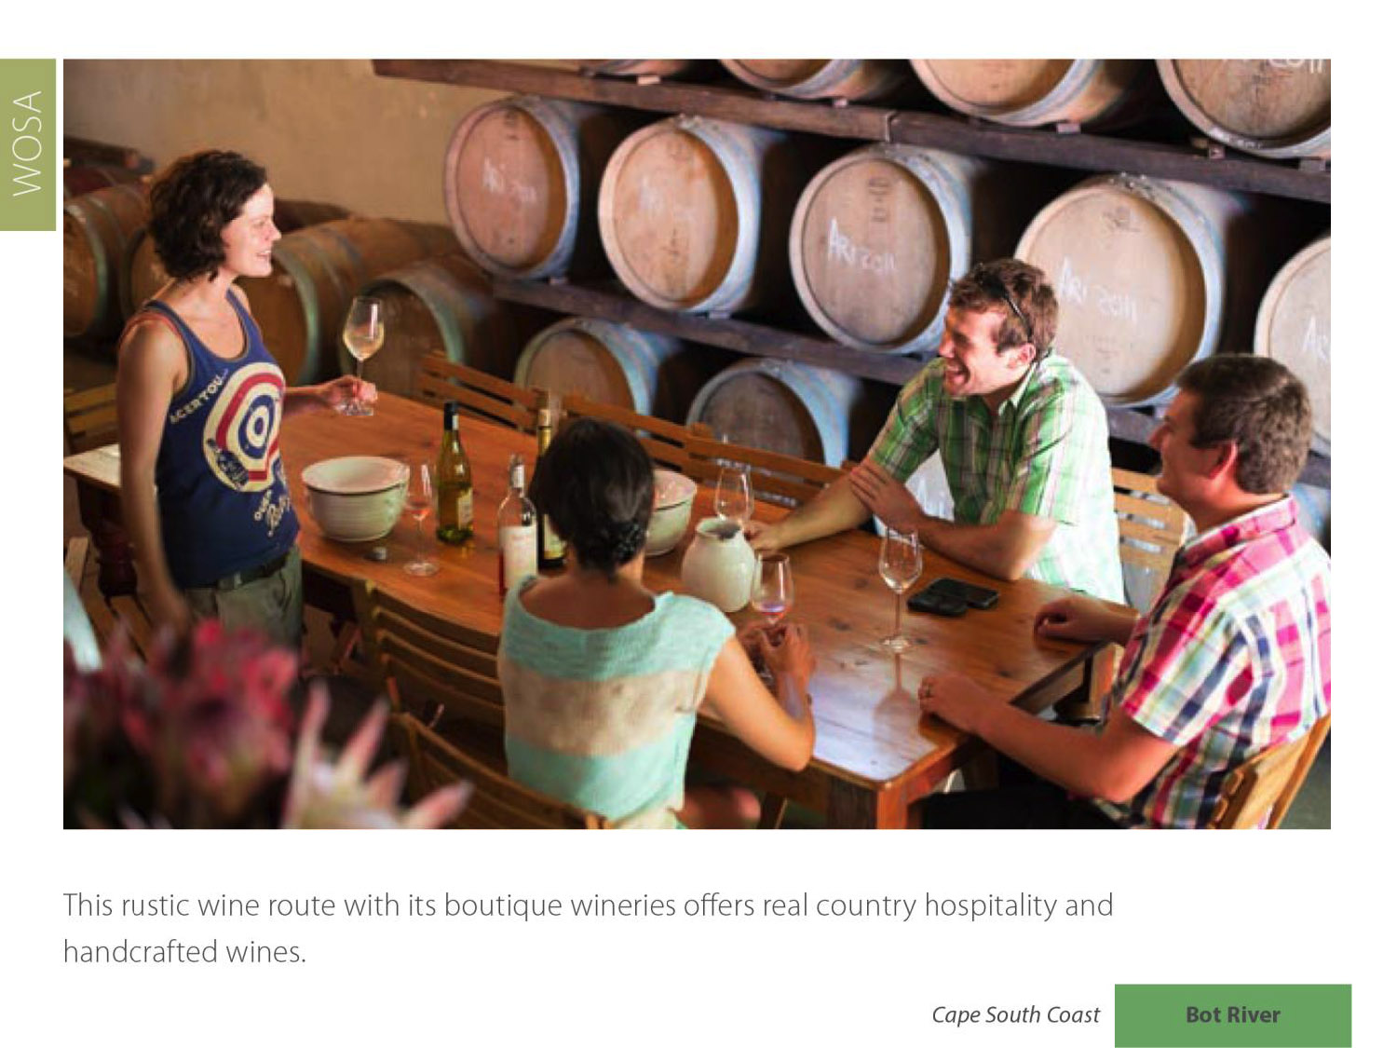
Bot River
Cape South Coast

Slide 16
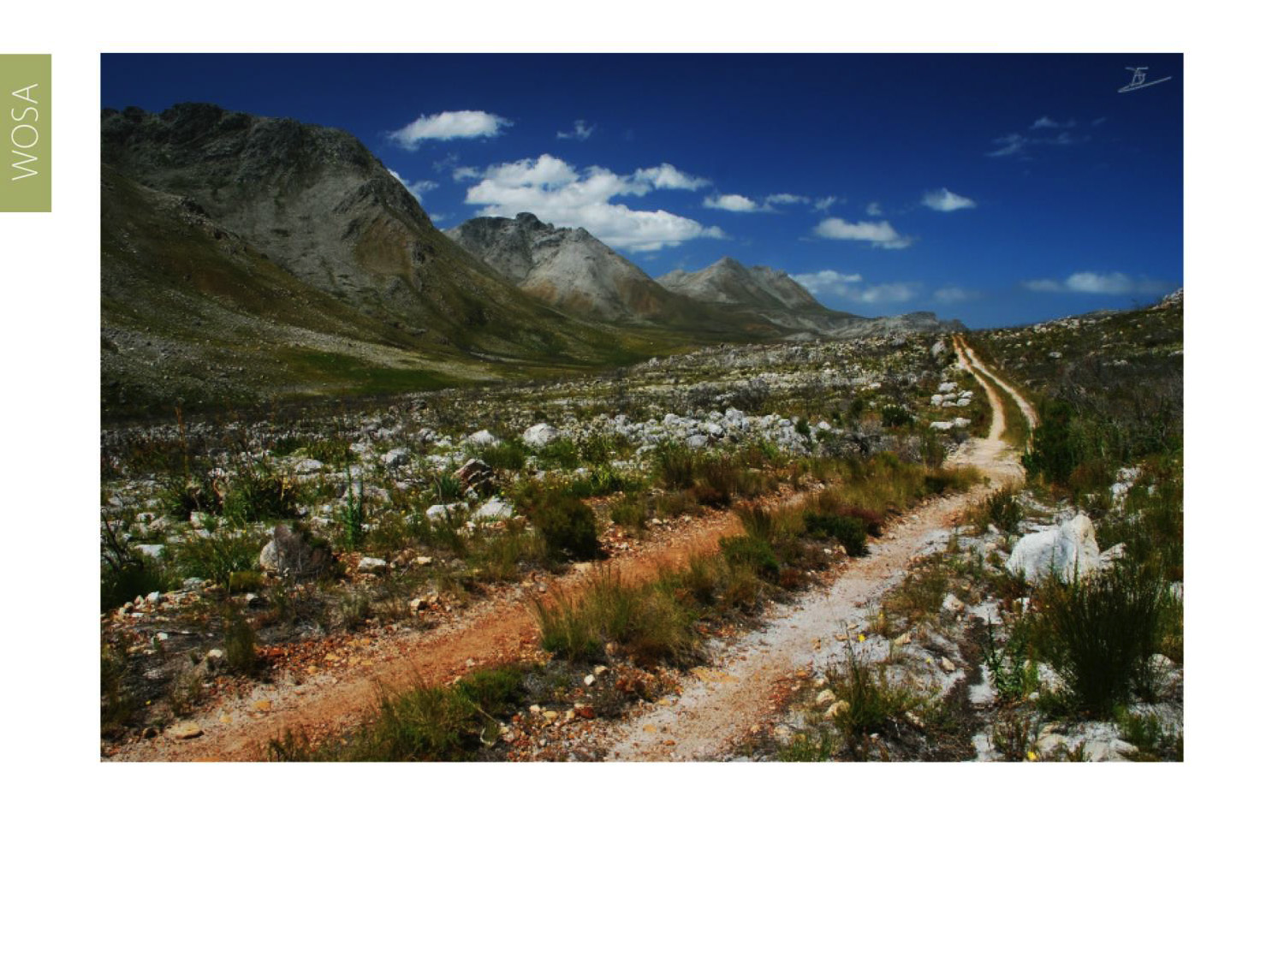
The ward borders the Kogelberg Biosphere. It is part of the Green Mountain Trail, the world’s first biodiversity wine route.
Bot River
Cape South Coast

Slide 17
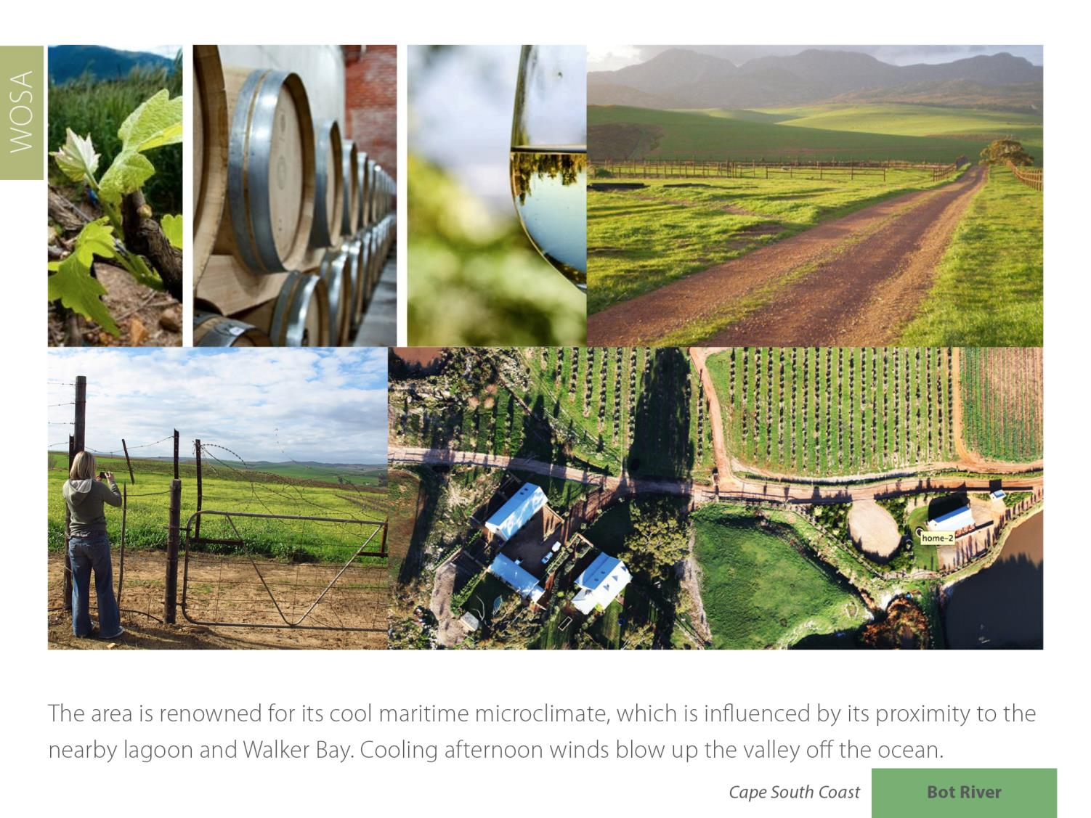
Bot River
Cape South Coast

Slide 18
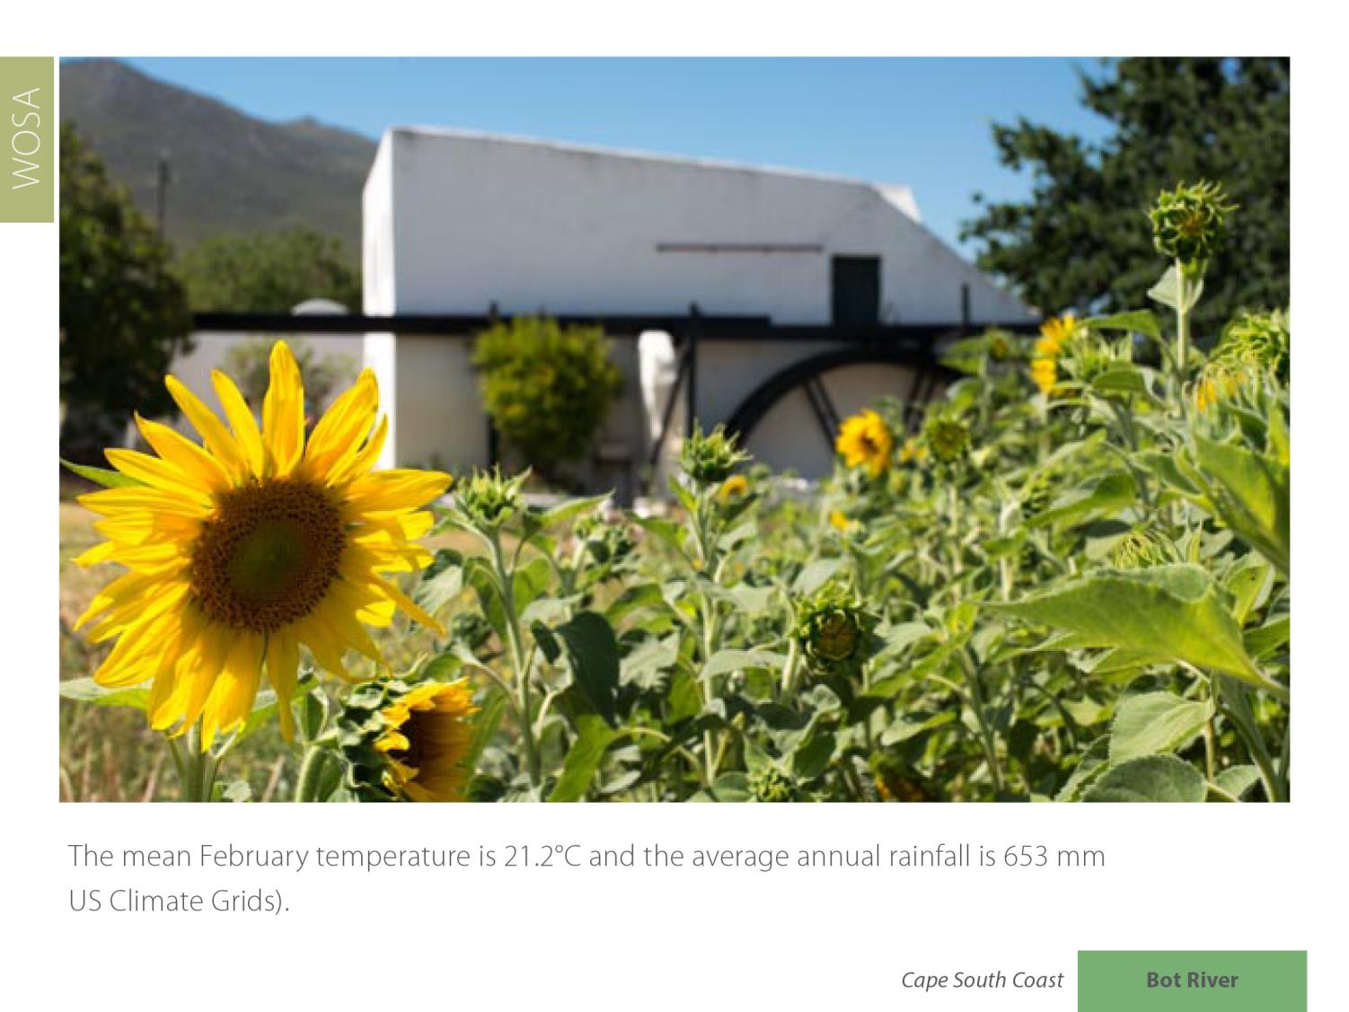
The mean February temperature is 21.2°C and the average annual rainfall is 653 mm (US Climate Grids).
Bot River
Cape South Coast

Slide 19
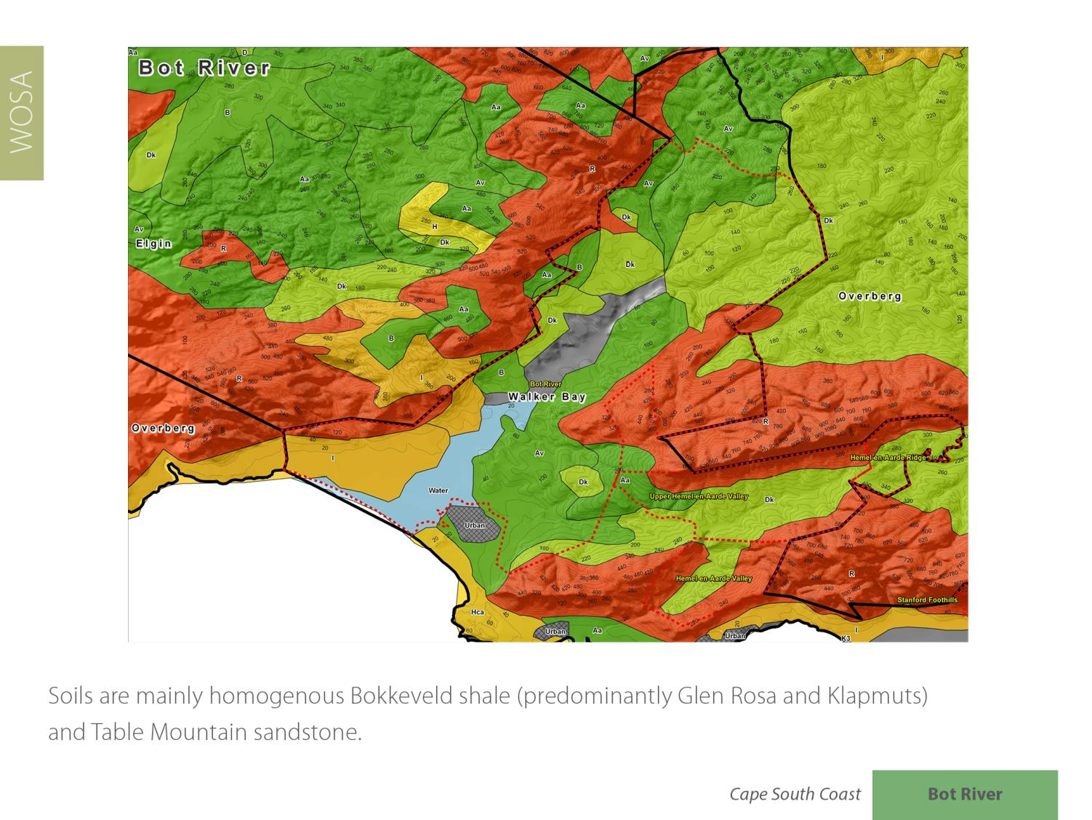
Bot River
Cape South Coast

Slide 20
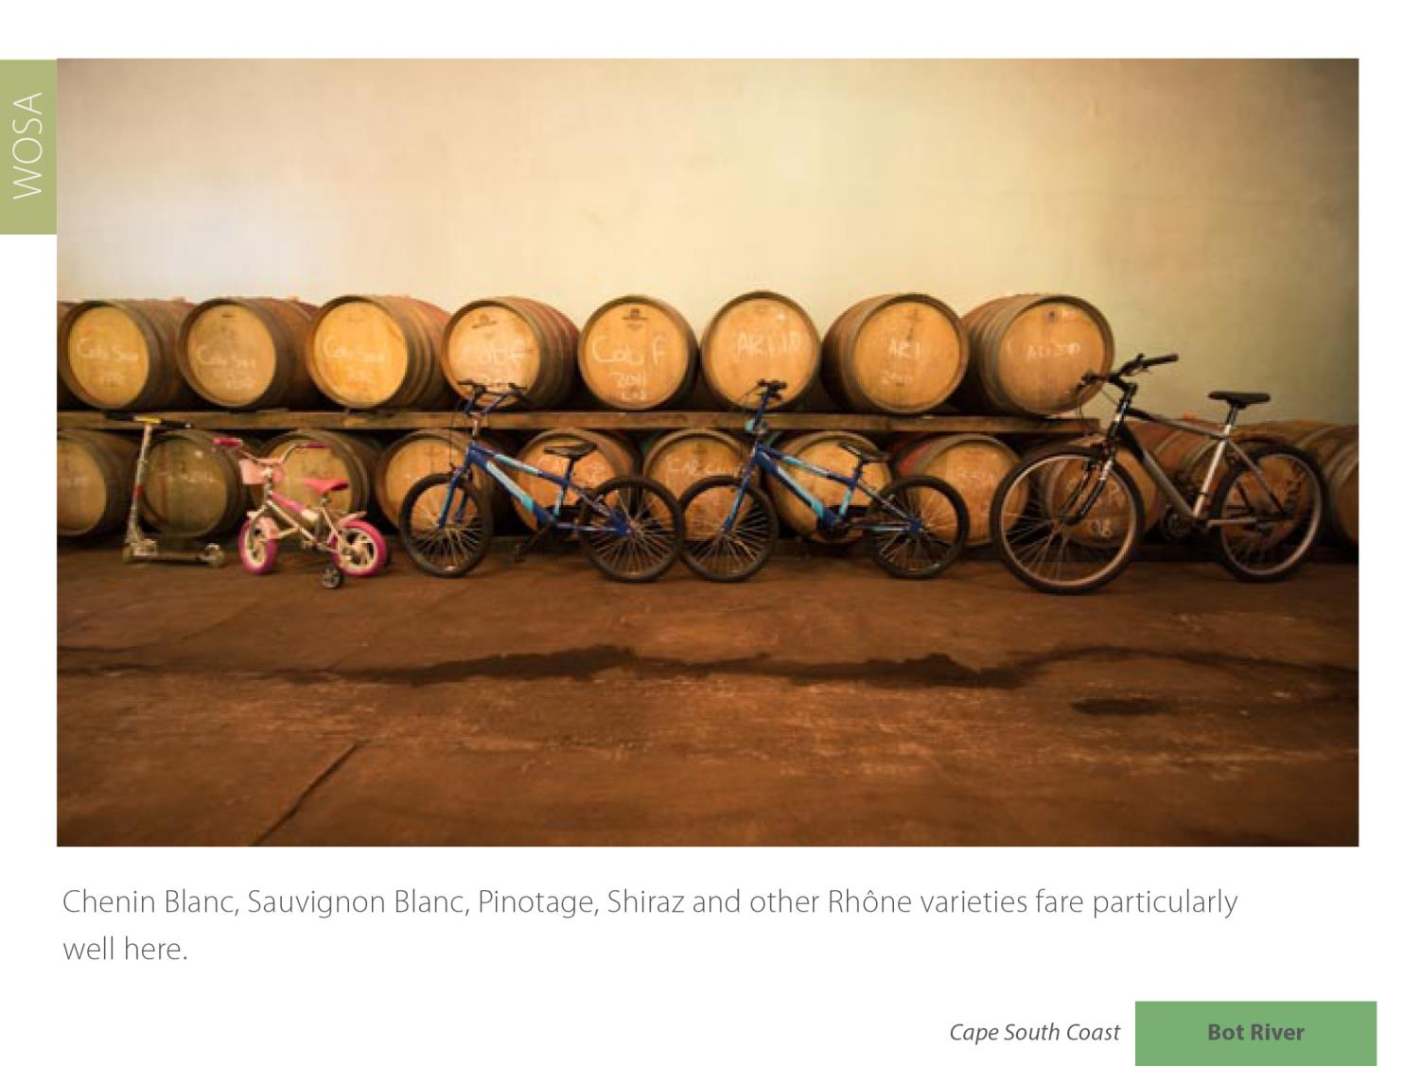
Bot River
Cape South Coast

Slide 21
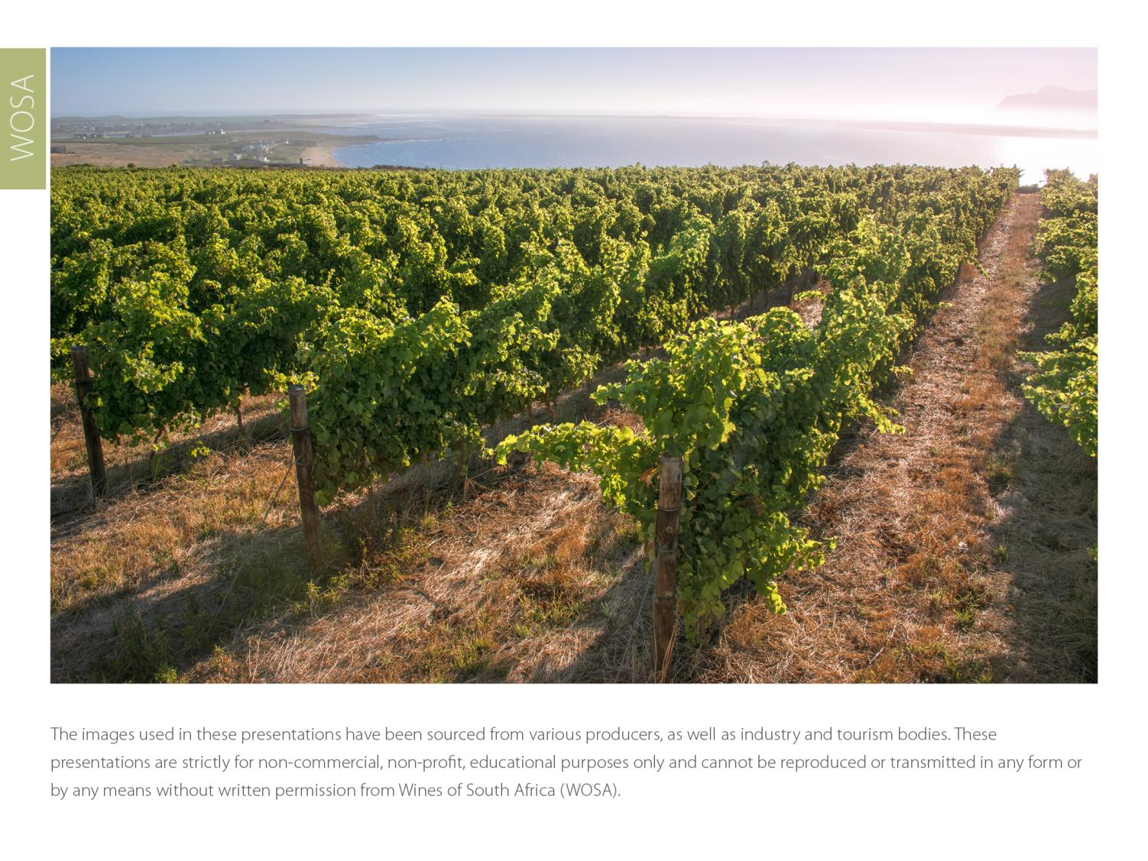
The images used in these presentations have been sourced from various producers, as well as industry and tourism bodies. These presentations are strictly for non-commercial, non-profit, educational purposes only and cannot be reproduced or transmitted in any form or by any means without written permission from Wines of South Africa (WoSA).

Slide 22
The Cape winelands, considered by many to be
the most beautiful in the world, have a network of
diverse and well-run wine routes, affording visitors
a varied and unforgettable experience.

Slide 23
THE END

